Slide 1
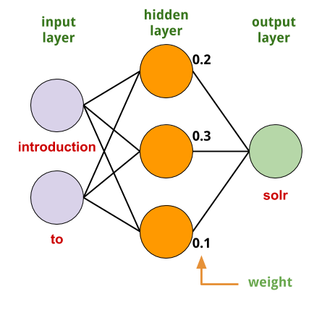
COMP 472 Experiments and Analysis for Mini Project 3
By Karim Ramy Boshra Botros (40179768), Ryan Amstutz (40170386) and Iris Radu (40179149)

Slide 2
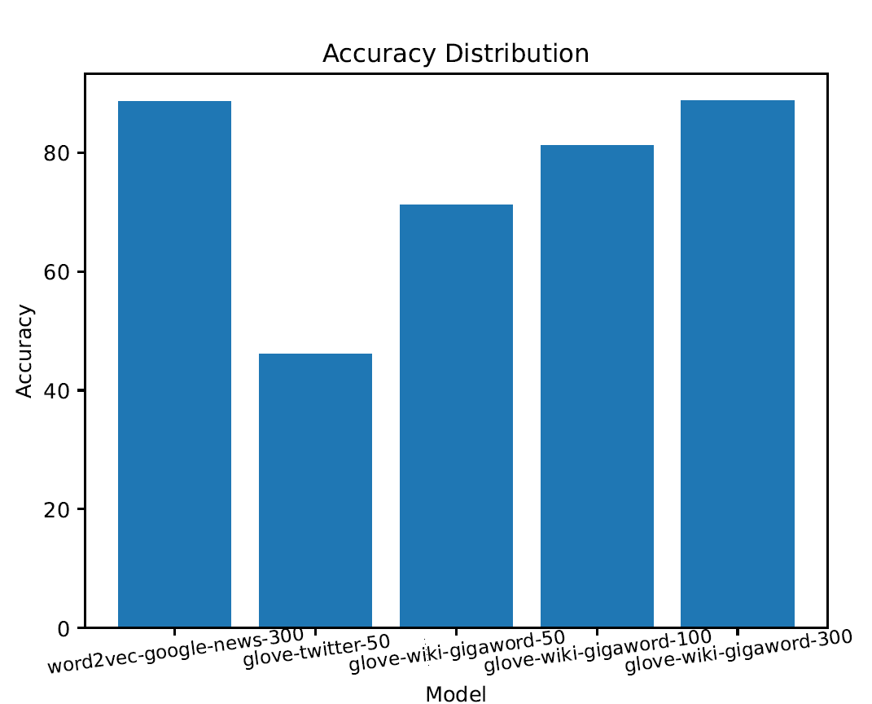
400 000 unique words
3 000 000 unique words
1 193 514 unique words

Slide 3
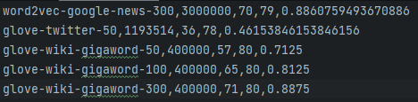
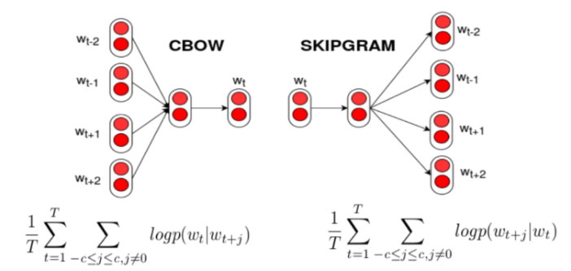
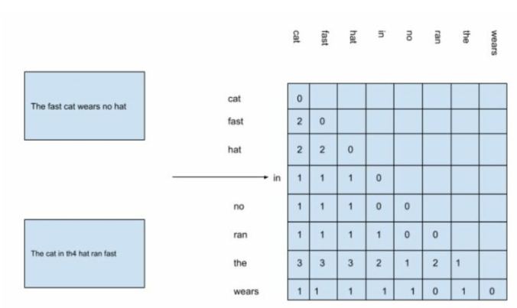
Some reasons for higher accuracy
Word2vec-google-news-300 and glove-wiki-gigaword-300 both have the same embedding size (300) which produces higher accuracy
word2vec
But why is glove-wiki-gigaword-300 just as good with only
400 000 unique words?
glove
glove is modeled with its own training procedure but is then converted to the same format as word2vec
Different training procedures
Reference: https://analyticsindiamag.com/word2vec-vs-glove-a-comparative-guide-to-word-embedding-techniques/

Slide 4
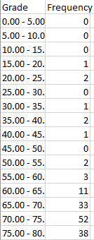
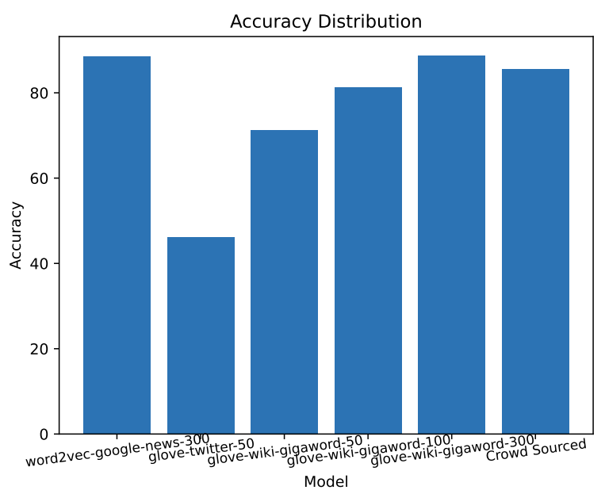
Comparison to human gold-standard
Human capacity to infer information from erroneous data:
One of the words for which the model had to find a synonym for is “tranquillity”, which is a misspelled version of “tranquility”.
The AI models had no reference for the misspelled word in the word embeddings, which forced it to guess an answer.
Humans on the other hand were able to deduce the correct spelling of the word and had a very high success rate in guessing its appropriate synonym.
Accuracy:
The crowdsourced distribution of grades had an average performance: 85.57%.
The best two models used (word2vec-google-news-300)
and (glove-wiki-gigaword-300)
had around ~89% accuracy.
The AI models outperformed humans in general.
A random baseline would have guessed with an accuracy of 25%, the AI models clearly outperformed the random baseline.

Slide 5
Exit(0)

